Slide 1
Salamander Macroevolution
Joanna & Jon

Slide 2
Salamander project
Pile of data:
Joanna had salamander measurements
Jon added fossils measurements
Tree from Pyron, geography from IUCN
Neoteny scores from literature search
Lots of turn-the-crank analyses
Seeking suggestions for
additional data
alternate analyses
structure

Slide 3
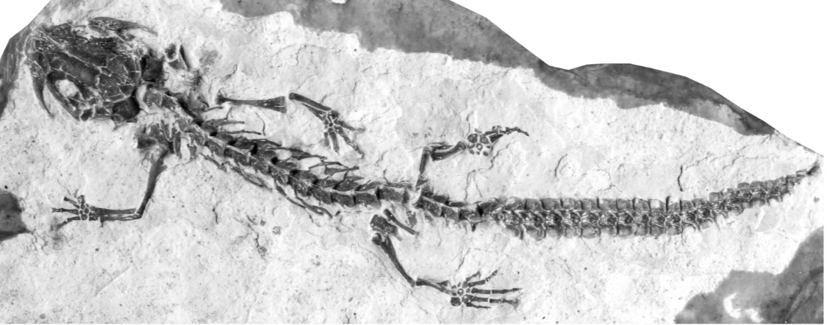
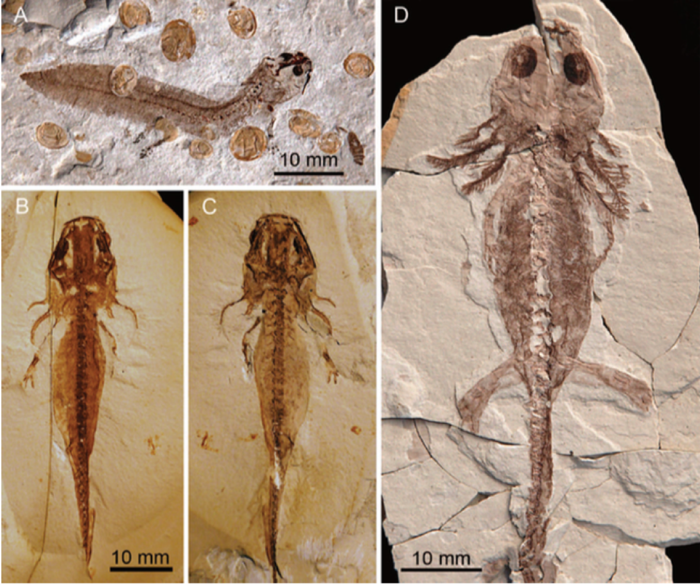
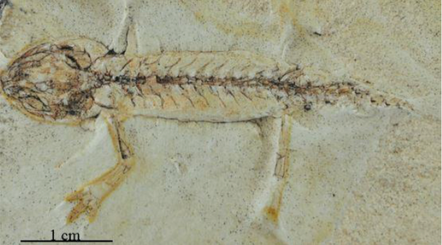
Fossil salamanders
Notes:
Salamander larvae from China
Ichthyosaura randeckensis from Randeck Maar in Germany
Taricha oliginacea from Gray Butte

Slide 4
Salamanders don’t care about:
The LDG

Slide 5
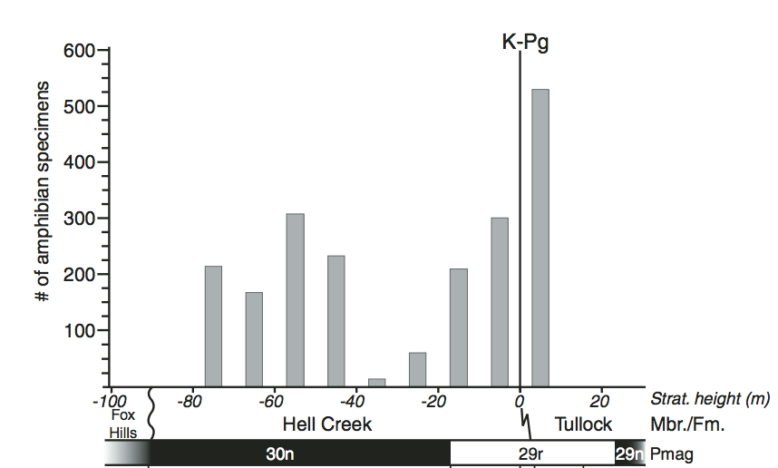
Salamanders don’t care about:
The LDG
The end-Cretaceous mass extinction
Wilson & DeMar 2014
Notes:
5/9 caudates disappeared locally from NWNA in Late K, but three of them came back. So 2/9 or ~22% extinction….
Sirenid Opisthotriton kayi was a “bloom” taxon in early Pg

Slide 6
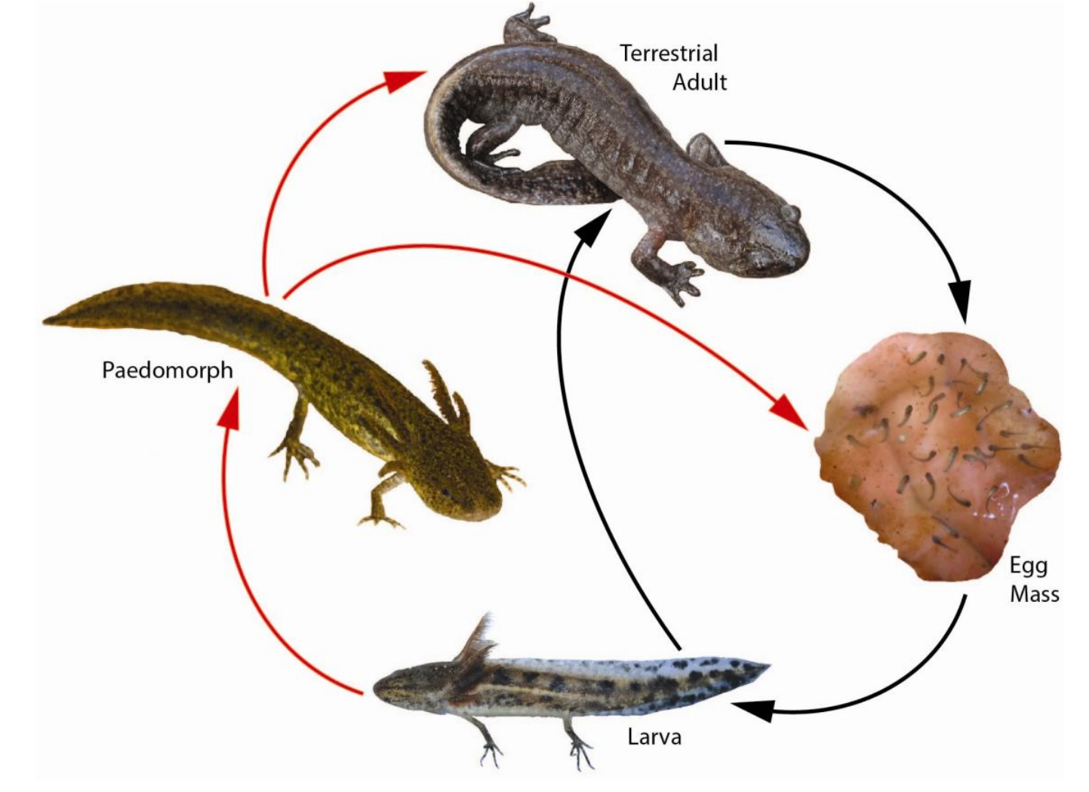
Salamanders don’t care about:
The LDG
The end-Cretaceous mass extinction
Developmental consistency
Walls et al 2013

Slide 7
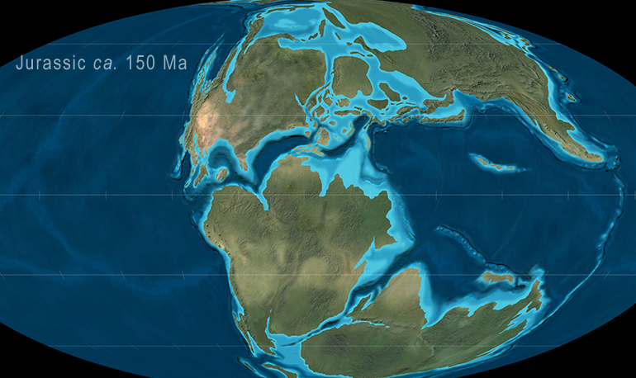
Salamanders don’t care about:
The LDG
The end-Cretaceous mass extinction
Development simplicity
Gondwana
Salamanders
No Salamanders
(Basically)

Slide 8
What we have
Data on:
Phylogeny (469 species; Pyron 2014)
Body size (Joanna’s measurements + fossils)
Geography (from IUCN)
Fossil occurrences (from PBDB; very lacking)
Neoteny (from literature; needs vetting)
Development

Slide 9
Angles of attack
Speciation & extinction rates
Body size evolution
Biogeography
Life history evolution

Slide 10
Salamander phylogeny
✝
✝
✝
✝
Notes:
Albanerpetontidae= scaly, fused frontals, record from K to Pliocene (outside Caudata)
Karauridae = large, neotenic Jurassic stem caudates from Eur/Central Asia
Scapherpetonids = large, aquatic siren-like caudates from NA (Scapherpeton tectum first Mesozoic sal named from NA)
Batrachosauroididae = large, aquatic, siren-like caudates from NA and Eur; Peratosauroides makes it to Pliocene (Opisthotriton is in this group)

Slide 11
Speciation & Extinction
469 extant species
84 fossil species with known phylogenetic placement
Append fossils to tree: ((A,B),X)
A
B
X
Notes:
Generated by fitting CR BD model to extant salamander phylo to get lambda and mu. Then calculated psi as # fossil occurrences / sum branch lengths on extant tree. Should be underestimate of psi given no fossil BRLENS

Slide 12
Speciation & Extinction
469 extant species
84 fossil species with known phylogenetic placement
Append fossils to tree: ((A,B),X)
A
B
X
Minimum
Missing
Unknown
Notes:
Generated by fitting CR BD model to extant salamander phylo to get lambda and mu. Then calculated psi as # fossil occurrences / sum branch lengths on extant tree. Should be underestimate of psi given no fossil BRLENS

Slide 13
Speciation & Extinction
469 extant species
84 fossil species with known phylogenetic placement
Append fossils to tree: ((A,B),X)
A
B
X
Minimum
Missing
Unknown
Notes:
Generated by fitting CR BD model to extant salamander phylo to get lambda and mu. Then calculated psi as # fossil occurrences / sum branch lengths on extant tree. Should be underestimate of psi given no fossil BRLENS

Slide 14
Plethodontids are problematic
Plethodontidae
Notes:
Young plethodontid fossils can be identified to genus, but no idea if same or different from extant species within that genus
Old plethodontid fossils can be identified, but no idea where they go on the tree

Slide 15
Ran fossilBAMM on trees with fossils
Fossil branches scaled by simple rates
Extant-only run
fossilBAMM with observed number of occurrences
fossilBAMM with 10X number of occurrences

Slide 16
Fossils change Salamandridae a lot
Speciation
Notes:
Pseudoeurycea, Eurycea, Appalachian Plethodon, Ambystoma and Hynobiids all have signif rate increases

Slide 17
Ran fossilBAMM on trees with fossils
Speciation through time
Extinction through time

Slide 18
Ran fossilBAMM on trees with fossils
Net div. through time
Relative extinction through time

Slide 19
Ran BAMM on snout-vent length
SVL Rate

Slide 20
Fossils smooth out size evolution
Notes:
Extant-only has lots of small size tips, but some depauperate clades are really big. Only way to accommodate is to have high rates at deep nodes. With fossils, lots of large taxa sprinkled through tree, so no need for a big jump.

Slide 21
Larger ancestral size at crown nodes

Slide 22
Biogeography of salamanders

Slide 23
Biogeography of salamanders

Slide 24
Six biogeographic provinces

Slide 25
BioGeoBEARS to infer ancestral ranges
Fossils present a problem
Treat observed ranges as “hard” or “soft” constraint
000100 vs ???1??
In-between options exist
Ambiguities “smear” fossils across provinces
Pro: Reflects uncertainty
Con: Unrealistically large ranges
DEC*+JV preferred model

Slide 26
Fossil constraints change critical nodes
Hard constraint
Soft constraint

Slide 27
Lineages-through-time per province
At time = t, find all edges alive
Find the probability each edge is in each province
Sum probs. for each province across edges alive at time = t

Slide 28
Focus on East Asia, Europe and Eastern NA
Hard constraint
Soft constraint

Slide 29
Compare estimate with fossil occurrences
Hard constraint
Soft constraint
Notes:
DeMar has more salamander occurrences in one paper from 2013 looking at Montana over ~2Ma than PBDB has for all salamanders everywhere through all time

Slide 30
Neoteny
No review of salamander neoteny
All families but Rhyacotritonidae
~10% of all species
Three states:
No neoteny (0; e.g., Salamandra salamandra)
Facultative neoteny (1; e.g., Ambystoma tigrinum)
Obligate neoteny (2; e.g., Amphiuma means)

Slide 31
Modeling neoteny
Potentially controlled by thyroid hormones
Use liability model to allow variance among clades

Slide 32
Neoteny on phylogeny

Slide 33
Plastic radiations (?)
Notes:
This is being driven by: Gyrinophilus, Eurycea, Hynobius retardatus, Salamndrids, and Ambystomatids

Slide 34
Plastic radiations (?)
Salamandridae
Eurcyea
Plethodon
Notes:
This is being driven by: Gyrinophilus, Eurycea, Hynobius retardatus, Salamndrids, and Ambystomatids

Slide 35
What say you all?
Additional data?
Different analyses?
General structure?

